Slide 1
DEGREE OF FREEDOM
PRESENTED BY
LEELAWATI PAIKRA

Slide 2
INTRODUCTION
A degree of freedom is an independent physical parameter in the formal description of the state of a physical system.

Slide 3
If the molecule is linear such as CO2 and the Z axis is the axis of that molecule ,then two independent modes of rotation around the X and Y axis would be possible.
In non-linear molecules such as H2O three types of rotation s are possible about three axes X,Y and Z that are perpendicular to each other.

Slide 4
FORMULA OF LINEAR MOLECULES
3N-5 for linear molecules
Where N = atom in molecules

Slide 5
FORMULA OF NON-LINEAR MOLECULES
3N-6 for non-linear molecules
Where N=atom in molecules

Slide 6
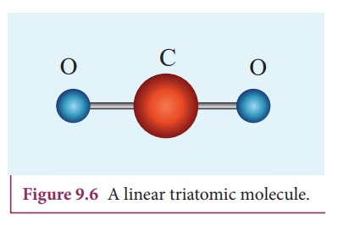
EXAMPELS OF DEGREE OF FREEDOM

Slide 7
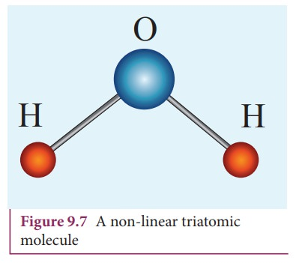
example

Slide 8
CALCULTE THE DEGREE OF FREEDOM IN MOLECULE
OCS =3N-5=4
O2 =3N-5=1
BCl3 =3N-6=6
CH4 =3N-6=9
CH3I =3N-6=9
C6H6 =3N-6=30
HBr =3N-5=1

Slide 9


